Slide 1
Housing Price Prediction - ML Project Report
This project demonstrates the use of Linear Regression to predict housing prices based on features such as area, number of bedrooms and bathrooms, and age of the house.

Slide 2
Load and Explore the Data
Dataset: sample_housing_data.csv
Features: Area (sqft), Bedrooms, Bathrooms, Age (years)
Target: Price

Slide 3
Data Visualization
Visualized relationships between features and price using scatter plots and correlation heatmap.

Slide 4
Train-Test Split & Model Training
Split data into 80% training and 20% testing. Trained a Linear Regression model on training data

Slide 5
Model Evaluation
Made predictions on test data. Calculated evaluation metrics:
Mean Squared Error: 110829179.80
R² Score: -0.11

Slide 6
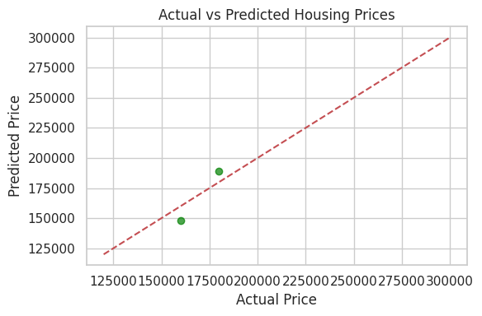
Actual vs Predicted Plot:

